Slide 1
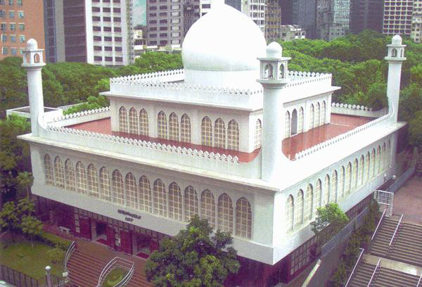
MIRACLES OF AL-QUR’AN
AND
QURAN & MODERN SCIENCE
Shuaibu Noohu Alim
Senior Imam Kowloon Masjid
2nd May 2015

Slide 2
Agenda
Miracles of the Prophets
Quran Miracles (Video – Part I):
  Amazing Scientific Truth on the Holy Quran (Math Miracle)
Quran Miracles
Quran Miracles (Video – Part II & III):
  Amazing Miracles of Islam in the Qura'n & Science
  10 Astonishing Quran verses describe black holes! Scientific miracles of the Quran
Quran Miracles: Embryology
Quran Miracles (Video – Part IV):
  Quran Miracles Challenge the Non-Beleivers - Universe

Slide 3
Definition of Miracle
an extraordinary and welcome event that is not explicable by natural or scientific laws and is therefore attributed to a divine agency.

Slide 4
Quran and Modern Science
Islam encourages insan to do ta’akal and ta’ffakur (contemplation)
إِنَّ فِي خَلْقِ السَّمَاوَاتِ وَالأَرْضِ وَاخْتِلاَفِ اللَّيْلِ وَالنَّهَارِ لآيَاتٍ
الألْبَابِ
‘Behold! In the creation of the heavens and the earth, there are indeed Signs for men of understanding.’ (3:190)

Slide 5
Miracles of the Prophets

Slide 6
Miracles of the Prophet - Ibraaheem (Abraham)
Ibraaheem rejected the practices of his people. They worshipped idols that could neither harm nor benefit them. One day, he destroyed the idols without anyone seeing him. When his people came to know that it was Ibraaheem who had done that, they prepared a huge fire and threw him into it. However, the fire did not burn Ibraaheem and did not affect him at all, as Allaah The Almighty ordered it not to burn him. Allaah The Almighty Says (what means): {They said, "Burn him and support your gods - if you are to act."Allaah Said, "O fire, be coolness and safety upon Abraham."And they intended for him harm, but We Made them the greatest losers.} [Quran 21:68-70]

Slide 7
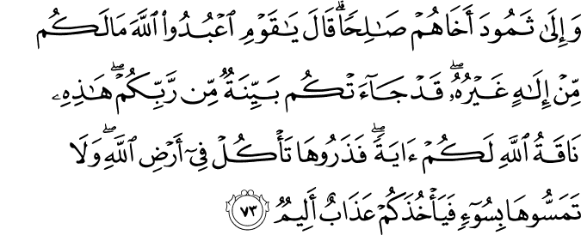
Miracles of the Prophet - Saalih
Allaah The Almighty sent Prophet Saalih to his people to call them to worship Allaah The Almighty alone, and not to associate any partners with Him. They asked him to bring them proof of what he was saying, so Allaah The Almighty supported him with the miracle of the she-camel. He made a unique she-camel emerge from between the mountain rocks. Some of them believed him, but the majority of them disbelieved and intended to kill the she-camel. Prophet Saalih warned them saying (what means): {And to the Thamud [We sent] their brother Salih. He said, "O my people, worship Allaah; you have no deity other than Him. There has come to you clear evidence from your Lord. This is the she-camel of Allaah [sent] to you as a sign. So leave her to eat within Allaah's land and do not touch her with harm, lest there seize you a painful punishment.}[Quran 7:73]

Slide 8
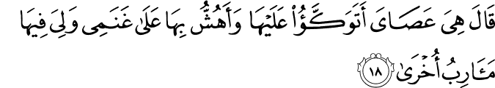
Miracles of the Prophet – Moosa (Moses)
Allaah The Almighty Says (what means): {And what is that in your right hand, O Moses?"He said, "It is my staff; I lean upon it, and I bring down leaves for my sheep and I have therein other uses." [Allaah] said, "Throw it down, O Moses." So he threw it down, and thereupon it was a snake, moving swiftly.} [Quran 20:17-20]
The staff was one of the miracles given to Prophet Moosa . By that staff, he defeated the magicians of Pharaoh, extracted water from rock and turned the sea into land by the permission of Allaah The Almighty so that He would save the believers and punish the disbelievers.

Slide 9
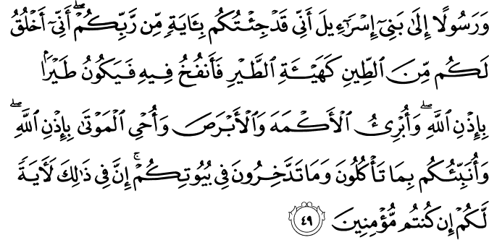
Miracles of the Prophet – Easa

Slide 10
Miracles of the Prophet – Easa
The miracle of Prophet ‘Eesa was that he cured the blind and the leper, and gave life to the dead by the permission of Allaah The Almighty. He would design the form of a bird from clay, breathe into itand it became a bird by the permission of Allaah The Almighty. Allaah The Almighty Says (what means): {And [make him] a messenger to the Children of Israel, [who will say], 'Indeed I have come to you with a sign from your Lord in that I design for you from clay [that which is] like the form of a bird, then I breathe into it and it becomes a bird by permission of Allaah. And I cure the blind and the leper, and I give life to the dead - by permission of Allaah. And I inform you of what you eat and what you store in your houses. Indeed in that is a sign for you, if you are believers.} [Quran 3:49]

Slide 11
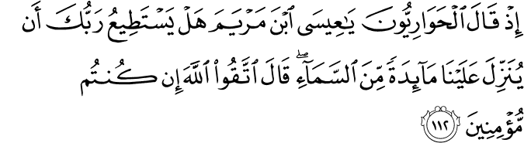
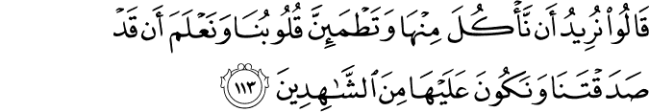
Miracles of the Prophet – Easa

Slide 12
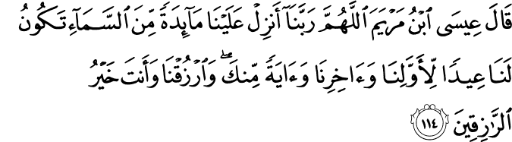
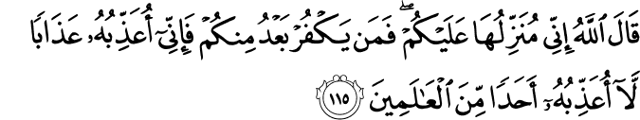
Miracles of the Prophet – Easa

Slide 13
Miracles of the Prophet – Easa
Another miracle of Prophet ‘Eesa was the table that was sent down from heaven with food. His people wanted him to ask Allaah The Almighty to send down a table spread with food so that their faith would increase. They urged him to supplicate His Lord to do so, and he warned them, but they insisted, so Allaah The Almighty sent down the table so that it would be a miracle of Prophet ‘Eesa . Allaah The Almighty Says (what means): {[And remember] when the disciples said, "O Jesus, Son of Mary, can your Lord send down to us a table [spread with food] from the heaven? [Jesus] said," Fear Allaah, if you should be believers."They said, "We wish to eat from it and let our hearts be reassured and know that you have been truthful to us and be among its witnesses."Said Jesus, the son of Mary, "O Allaah, our Lord, send down to us a table [spread with food] from the heaven to be for us a festival for the first of us and the last of us and a sign from You. And provide for us, and You are the best of providers. "Allaah said, "Indeed, I will send it down to you, but whoever disbelieves afterwards from among you - then indeed will I punish him with a punishment by which I have not punished anyone among the Worlds."}[Quran 5: 112-115]

Slide 14
Miracles of the Prophet – Muhammad
The literal splitting of the moon is a miracle attributed to Prophet Muhammad by early traditions transmitted on the authority of the companions of Muhammad such as Ibn Abbas, Anas bin Malik, Abdullah bin Masud and others
Narrated Abdullah bin Masud: "During the lifetime of the Prophet the moon was split into two parts and on that the Prophet said, 'Bear witness (to thus).'"
Sahih Bukhari 4:56:830
Narrated Anas: "That the Meccan people requested Allah's Apostle to show them a miracle, and so he showed them the splitting of the moon."
Sahih Bukhari 4:56:831

Slide 15
“Thajuddin (R.A)” known as “Cheraman Perumal”
The First Indian to accept Islam
Cheraman Perumal, (Tajuddin. r.a) king of india-Kodungallur, Kerala (AD 622-628. Hijra 1-7) was the first Indian to accept Islam. Many historians have recorded this fact in their writings. Kerala is a state of India. The state stretches for 360 miles (580 kilometers) along the Malabar Coast on the southwestern side of the Indian peninsula. King Chakrawati Farmas of Malabar was a Chera king, Cheraman perumal of Kodungallure. He is recorded to have seen the moon split. The incident is documented Hamidulla writes in "Muhammad Rasoolullah in a manuscript kept at the India Office Library, London, reference number: Arabic, 2807, 152-173 A group of Muslim merchant passing by Malabar on their way to China spoke to the king about how God had supported the Arabian prophet with the miracle of splitting of the moon. The shocked king said he had seen it with his own eyes as well, deputized his son, and left for Arabia to meet the Prophet in person. He embraced Islam at the hand of the Prophet and when returning home, at the direction of the Prophet, died at the port of Zafar, Yemen,(Present salalah Oman) where the tomb of the Indian king was piously visited for many centuries

Slide 16
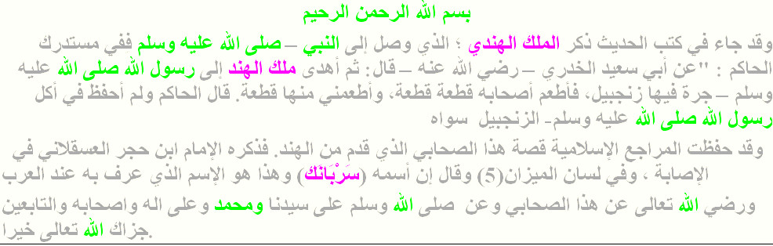

Slide 17
Cheraman Juma Masjid the first mosque of India
Cheraman Juma Masjid the first mosque of India. Built in 629 AD, this is the first mosque in India and the second in the world where Juma prayers were started. People from far and near irrespective of caste and creed visit this holy place and pay their homage. This mosque has a unique specialty. Mosques built all over the world face the direction of Mecca, but this particular one faces along the east.
The first mosque in India is Situated in Kodungalloor, Legend says King Cheraman Perumal of Kodungallur left for Mecca, embraced Islam, accepted the name Thajudeen, married the sister of the then King of Jeddah. Before his death Thajuddeen handed over to the King of Jeddah several letters addressed to Kerala Kings seeking their help to propagate Islam. The Jiddah king came to Kerala and met the then king of Kodungalloor who helped the former to build a Juma Masjid.The first mosque in India.
Kodungallur
Dr.Navas, K.J.Hospital

Slide 18
Quran Miracles
Video (Part I): Quran Miracles (Video – Part I): Amazing Scientific Truth on the Holy Quran (Math Miracle)

Slide 19
Quran Miracles
Video (Part I): Quran Miracles (Video – Part I): Amazing Scientific Truth on the Holy Quran (Math Miracle)
https://www.youtube.com/watch?v=GlaMjz4Kp6M

Slide 20
Quran Miracles

Slide 21
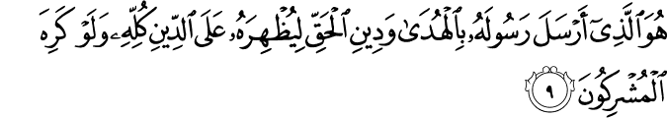
Islamic dominance
“We have, without doubt, Sent down the Message; And We will assuredly Guard it (from corruption)” (15:9).[16]
“It is He Who has sent His Apostle with Guidance And the Religion of Truth, That he may proclaim it Over all religion, Even though the Pagans May detest (it)” (61:9).[16]
The Quran predicted that Islam would prevail and even dominate the religions of the world until the day of judgment.

Slide 22
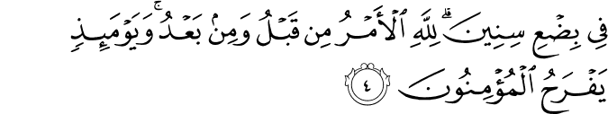
War Prophecy
The Quran predicted the defeat of the Persians by the Romans. Before the prophecy, at the Battle of Antioch, in 613 C.E., the Persians defeated the Romans. The Muslims supported Romans due to Semitic relations. But a few years later the following verse from the Quran was revealed:
The Byzantines have been defeated (30:2)
In the nearest land. But they, after their defeat, will overcome. (30:3)
Within three to nine years. To Allah belongs the command before and after. And that day the believers will rejoice (30:4)
In 627 C.E. the Romans successfully defeated the Persians and the Muslims had celebrations.

Slide 23
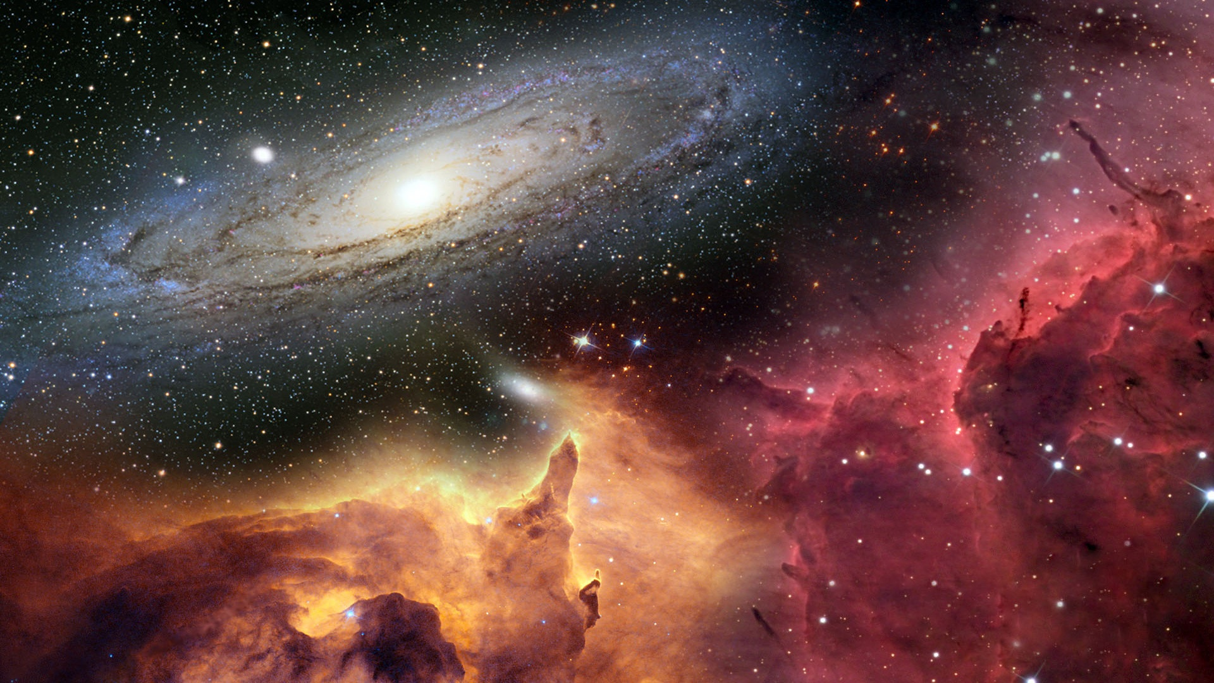
Expansion of Universe
And the heaven We constructed with strength, and indeed, We are [its] expander. (51:47)
Only after a few scientific breakthroughs was it discovered that the earth and our solar system were not the only existent objects in this world.

Slide 24
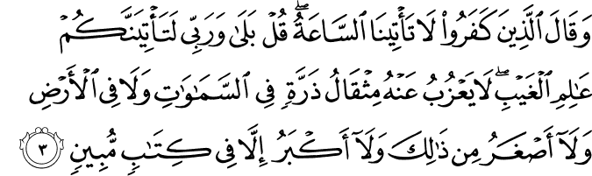
Existence of sub-atomic particles
But those who disbelieve say, "The Hour will not come to us." Say, "Yes, by my Lord, it will surely come to you. [ Allah is] the Knower of the unseen." Not absent from Him is an atom's weight within the heavens or within the earth or [what is] smaller than that or greater, except that it is in a clear register – (34:3)
Once again this is related to the field of science. A theory known as the “Theory of Atomism” was widely recognized and accepted by people across the globe. In the 20th century mankind learnt that atoms can be further split down to what we know we today know as. Protons, Electrons and Neutrons. This however was already evident in the Quran in the 7th century.

Slide 25
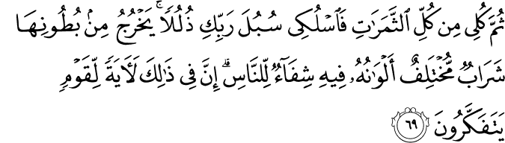
Honey
Then eat from all the fruits and follow the ways of your Lord laid down [for you]." There emerges from their bellies a drink, varying in colours, in which there is healing for people. Indeed in that is a sign for a people who give thought. (16:69)
Honey as most of us know today is used for healing a wound. Only a couple of centuries ago did man come to realize that honey came from the belly of the bee. However once again the Quran mentioned this 1400 years ago!

Slide 26
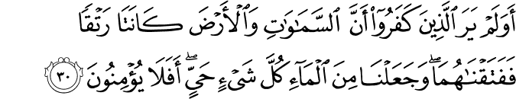
Water
Have those who disbelieved not considered that the heavens and the earth were a joined entity, and We separated them and made from water every living thing? Then will they not believe? (21:30)
Water has been an essential part of mankind since the existence of the first man. Biologically the cytoplasm is made up of about 80% of water. The average living organism contains from anywhere between 50%-90% of water. It would have not been possible for the people of the 7th century to even make an assumption that water makes up most of us.

Slide 27

Mountains are pegs
And the mountains He set firmly (79:32)
Geography proves that the earth is divided to what we know as plates. On the boundaries of these plates is where mountains are formed. Once again the Quran reveals this 1400 years ago.

Slide 28
Sweet and salt
He released the two seas, meeting [side by side]; (55:19)
Between them is a barrier [so] neither of them transgresses. (55:20)
There are two oceans in this world that meet with an invisible barrier. Each with its own salinity, temperature and density. When they do crossover the water completely loses its own characteristics and takes up the form of the side of the ocean. This phenomenon is confirmed by renowned scientist Dr. William Hay

Slide 29
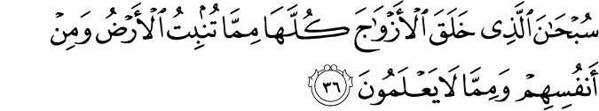
Plants and gender
Exalted is He who created all pairs - from what the earth grows and from themselves and from that which they do not know. (36:36)
Until recently man has always thought that the plant has no male or female gender. In the Quran God says that for every item in this world there is a pair, even for a plant.

Slide 30
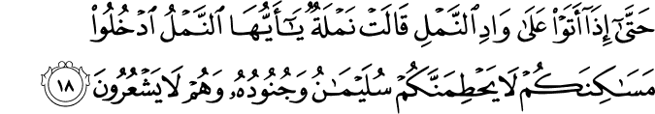
Ants sophisticated communication
And gathered for Solomon were his soldiers of the jinn and men and birds, and they were [marching] in rows.(27:17)
Until, when they came upon the valley of the ants, an ant said, "O ants, enter your dwellings that you not be crushed by Solomon and his soldiers while they perceive not.“ (27:18)
Even we today we would consider the communications of animals absurd. Recent researches prove that ants share some human rituals.
“(a) The ants bury their dead in a manner similar to the humans; (b) They have a sophisticated system of division of labour, whereby they have managers, supervisors, foremen, workers, etc.; (c) Once in a while they meet among themselves to have a ‘chat’.; (d) They have an advanced method of communication among themselvesWhen King Solomon was returning from battle the ants told each other to hide underground so as not to be stepped on.

Slide 31
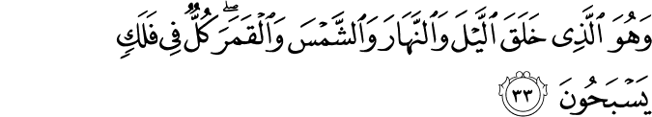
Orbit
And it is He who created the night and the day and the sun and the moon; all [heavenly bodies] in an orbit are swimming.(21:33)
Man has always thought that the earth was the center and everything revolves around it. The Quran clearly states that even the Sun is in orbit and scientist prove this. The sun orbits the star Vega in a particular orbit called the Solar Apex.

Slide 32
Fingerprints
Does man think that We will not assemble his bones? (75:3)
Yes. [We are] Able [even] to proportion his fingertips. (75:4)
Without microscopes we would have not been able to tell that our fingerprints were all different even from twins. The Quran as mentioned above says that God will reassemble you perfectly till your very fingertips. This signifies the differences in our fingertips. Once again for this to be proven, microscopes were needed and 14th centuries ago microscope were not even thought of.

Slide 33
Forelock
No! If he does not desist, We will surely drag him by the forelock – (96:15)
A lying, sinning forelock. (96:16)
Research carried out in recent years revealed that the prefrontal area, which is responsible for the management of particular functions of the brain, lies in the frontal part of the skull. So, this area of the cerebrum is responsible for planning, motivation, and initiating good and sinful behaviour, and is responsible for telling lies and the truth. Once again not even an assumption could be made relating to this back then.

Slide 34
Quran Miracles
Video (Part II): Amazing Miracles of Islam in the Qura'n & Science

Slide 35
Quran Miracles Video (Part II): Amazing Miracles of Islam in the Qura'n & Science
https://www.youtube.com/watch?v=XUO6icOR2zc

Slide 36
Quran Miracles Video (Part III):
10 Astonishing Quran verses describe black holes! Scientific miracles of the Quran

Slide 37
Quran Miracles Video (Part III):
10 Astonishing Quran verses describe black holes! Scientific miracles of the Quran
https://www.youtube.com/watch?v=g7BPeVRqBRM

Slide 38
Quran Miracles: Embryology

Slide 39
EMBRYOLOGY
MAN IS CREATED FROM ALAQ
A LEECH-LIKE SUBSTANCE

Slide 40
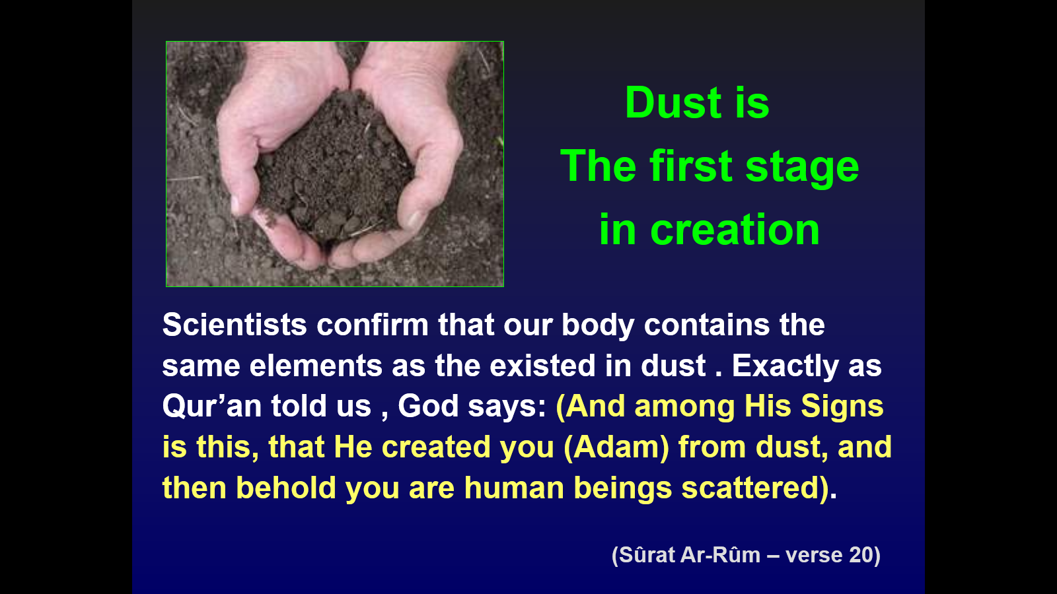
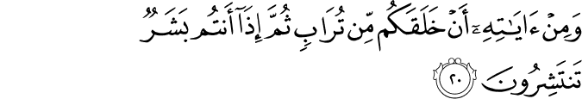

Slide 41
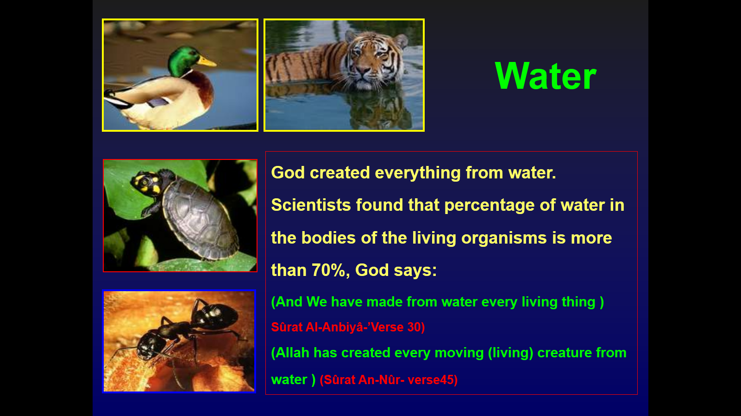
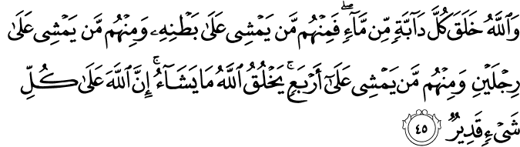

Slide 42
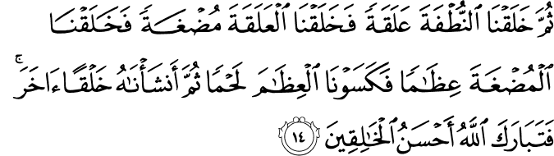
God says in surat Al-Mu’minum (verse 12-14)

Slide 43
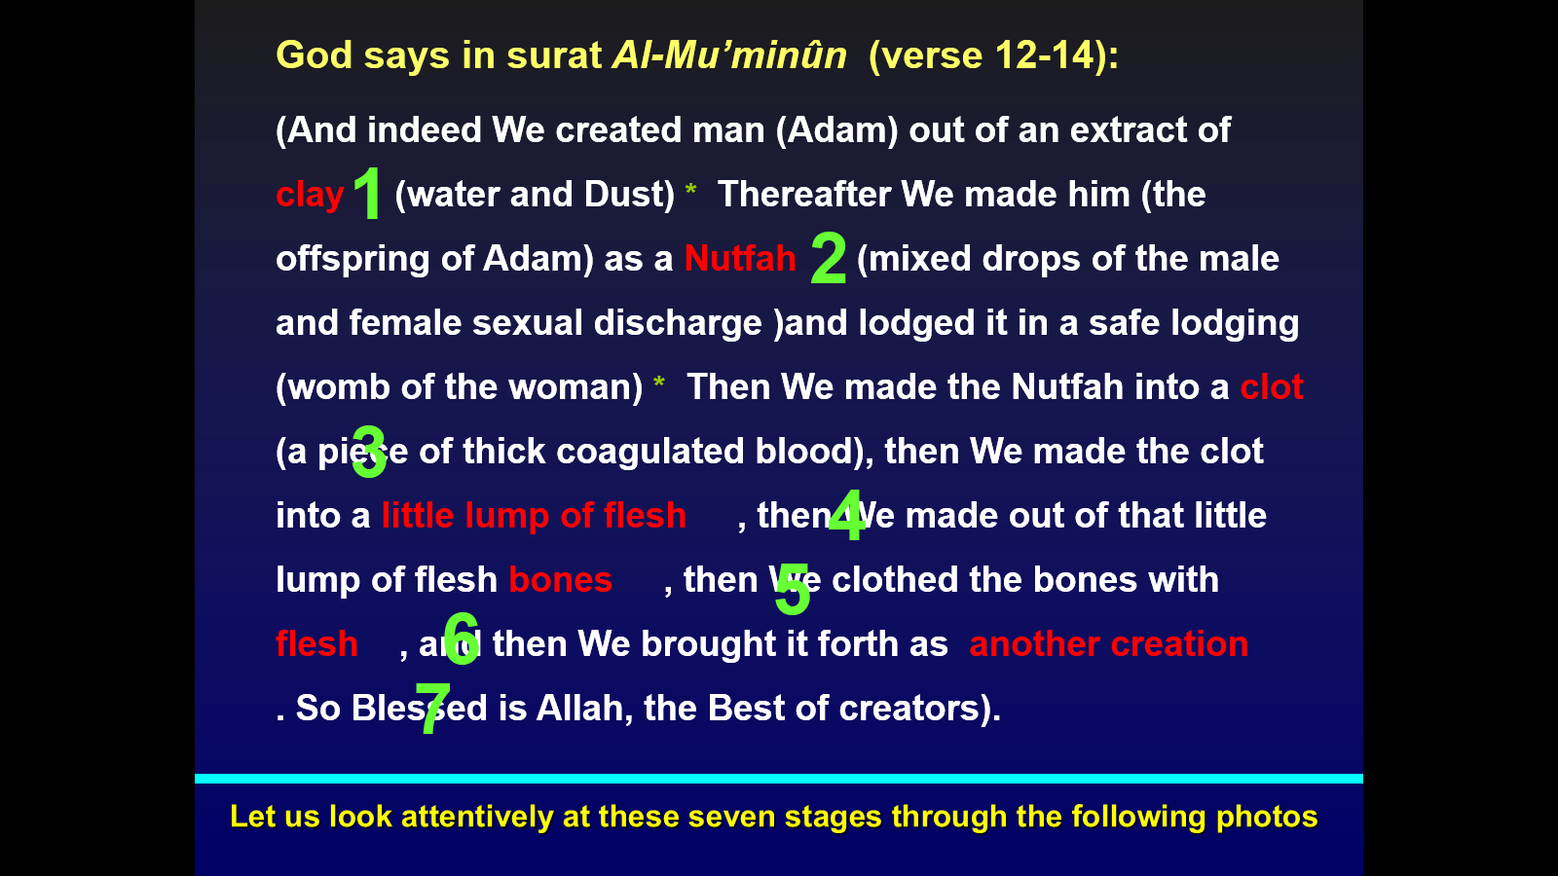

Slide 44
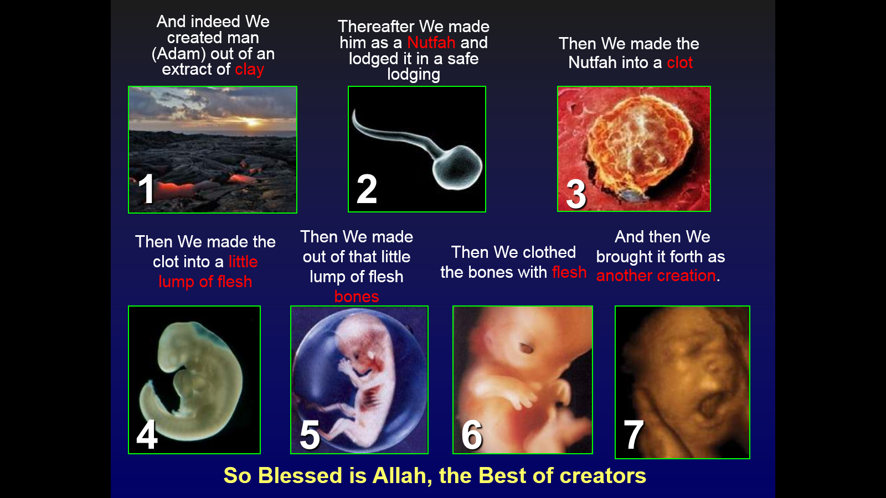

Slide 45
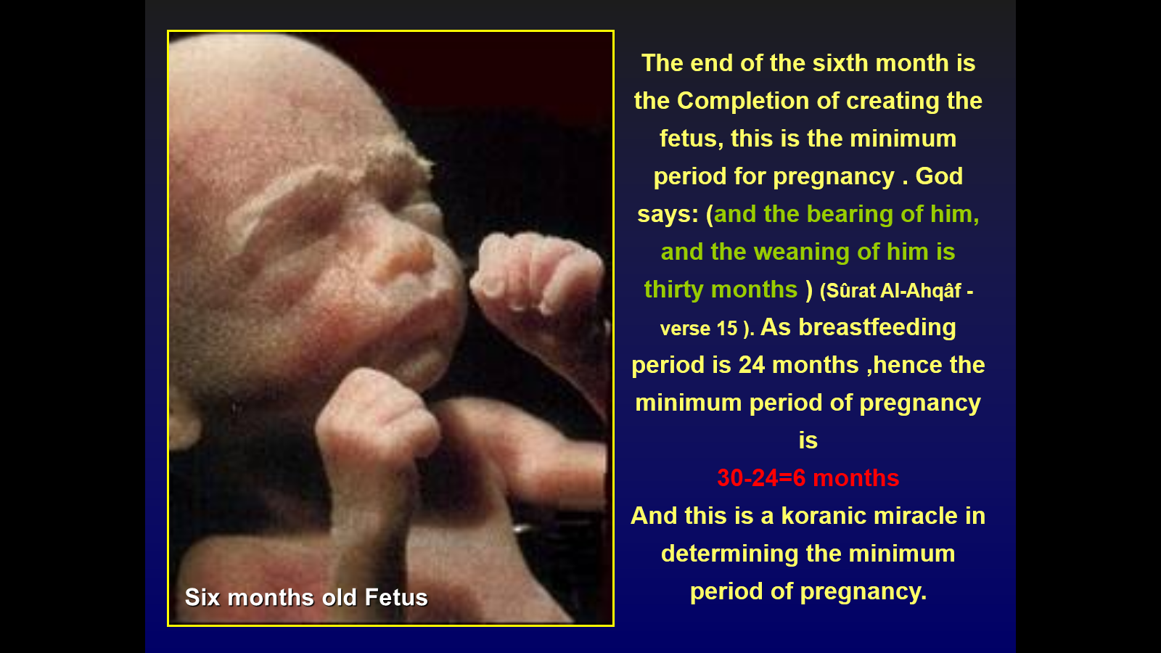
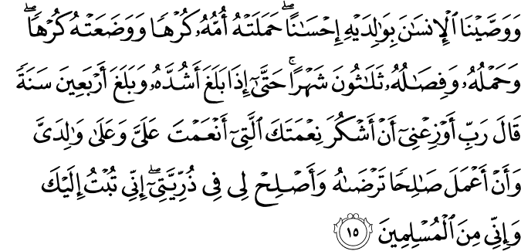

Slide 46
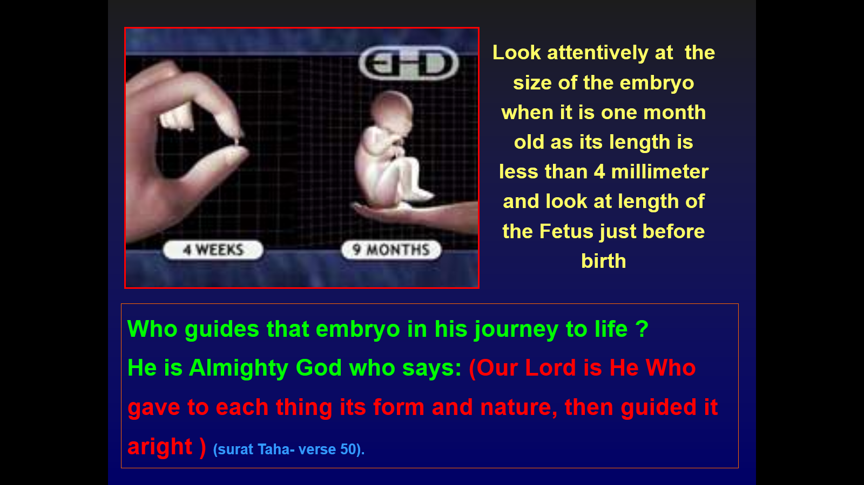

Slide 47
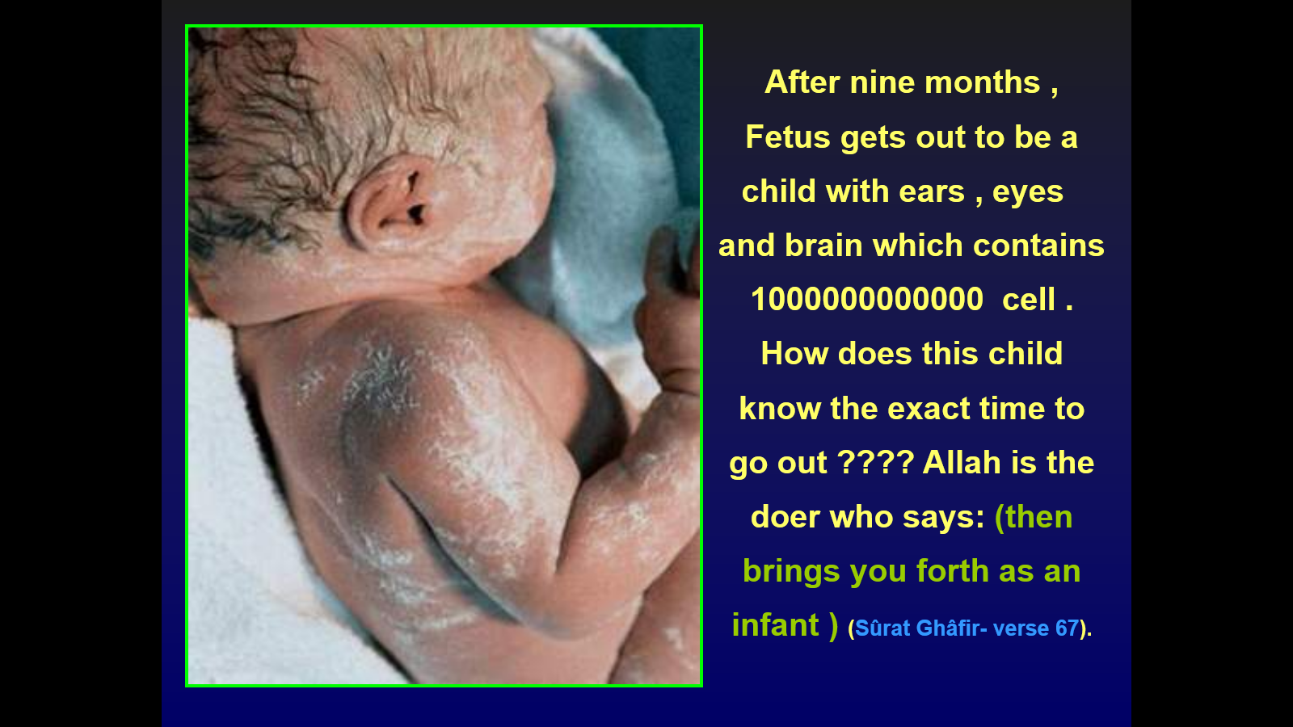
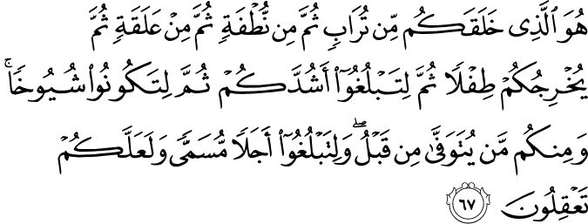

Slide 48
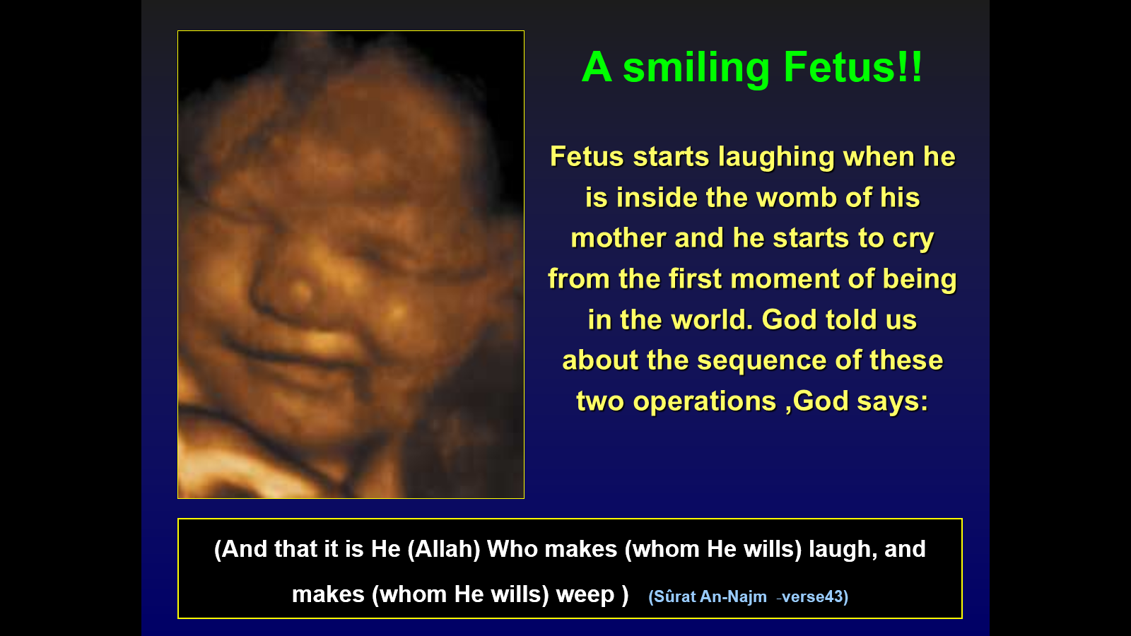

Slide 49
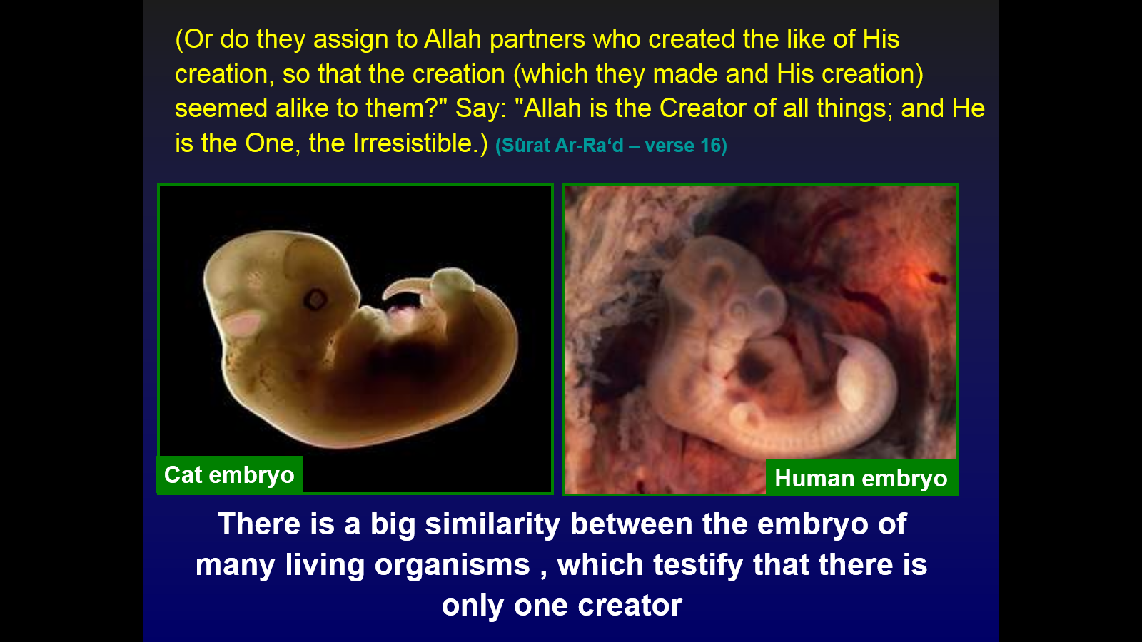
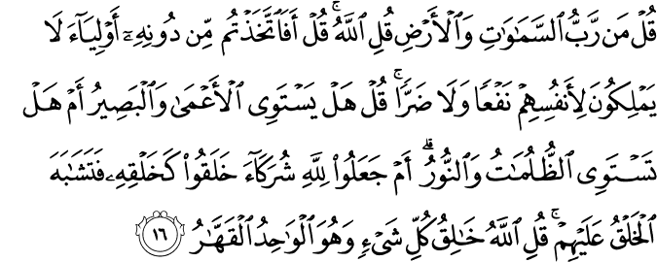

Slide 50
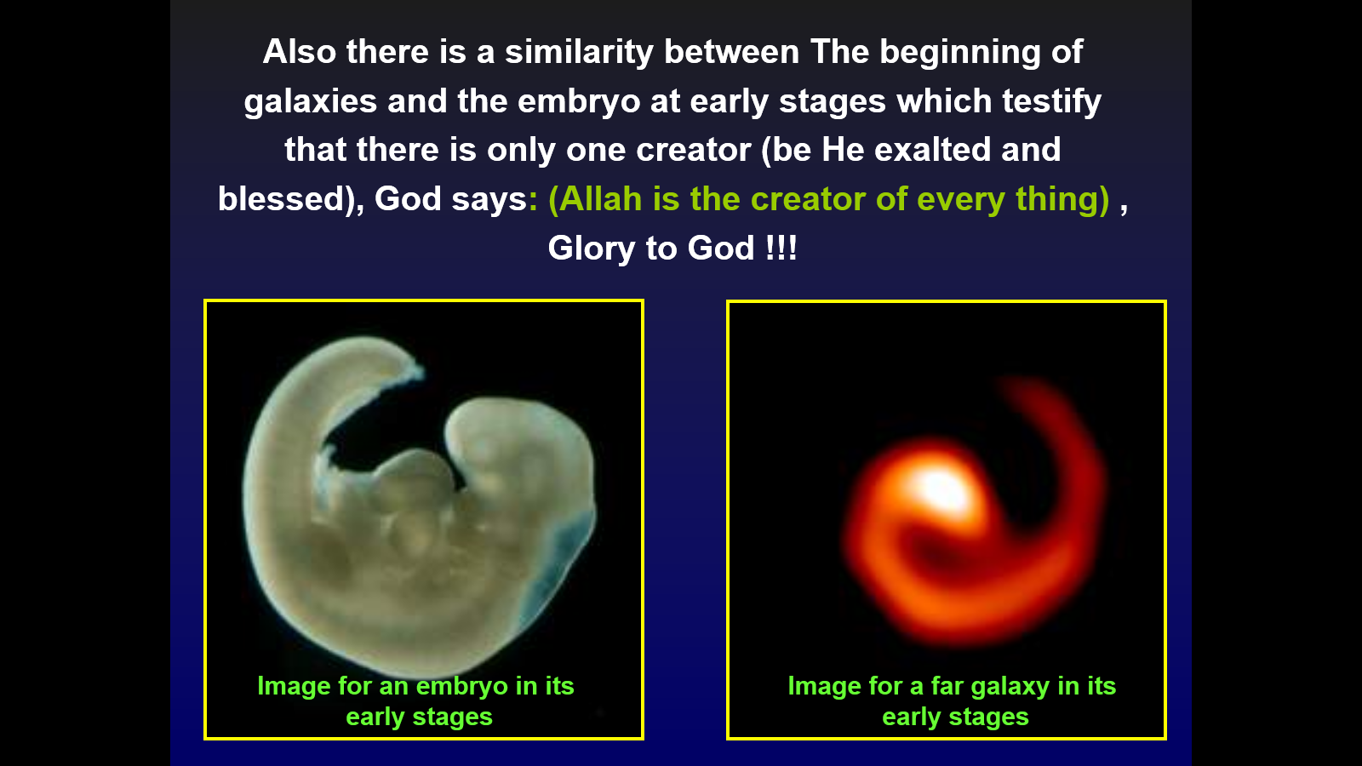

Slide 51
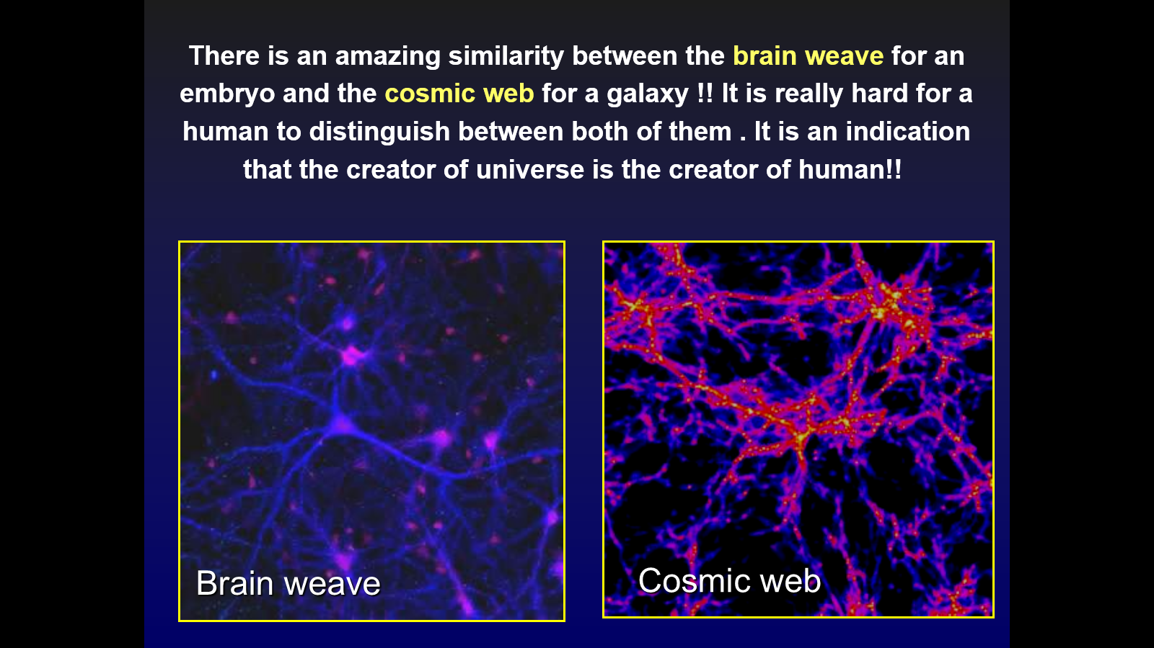

Slide 52
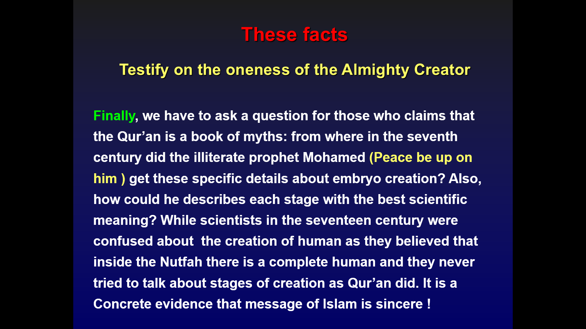

Slide 53
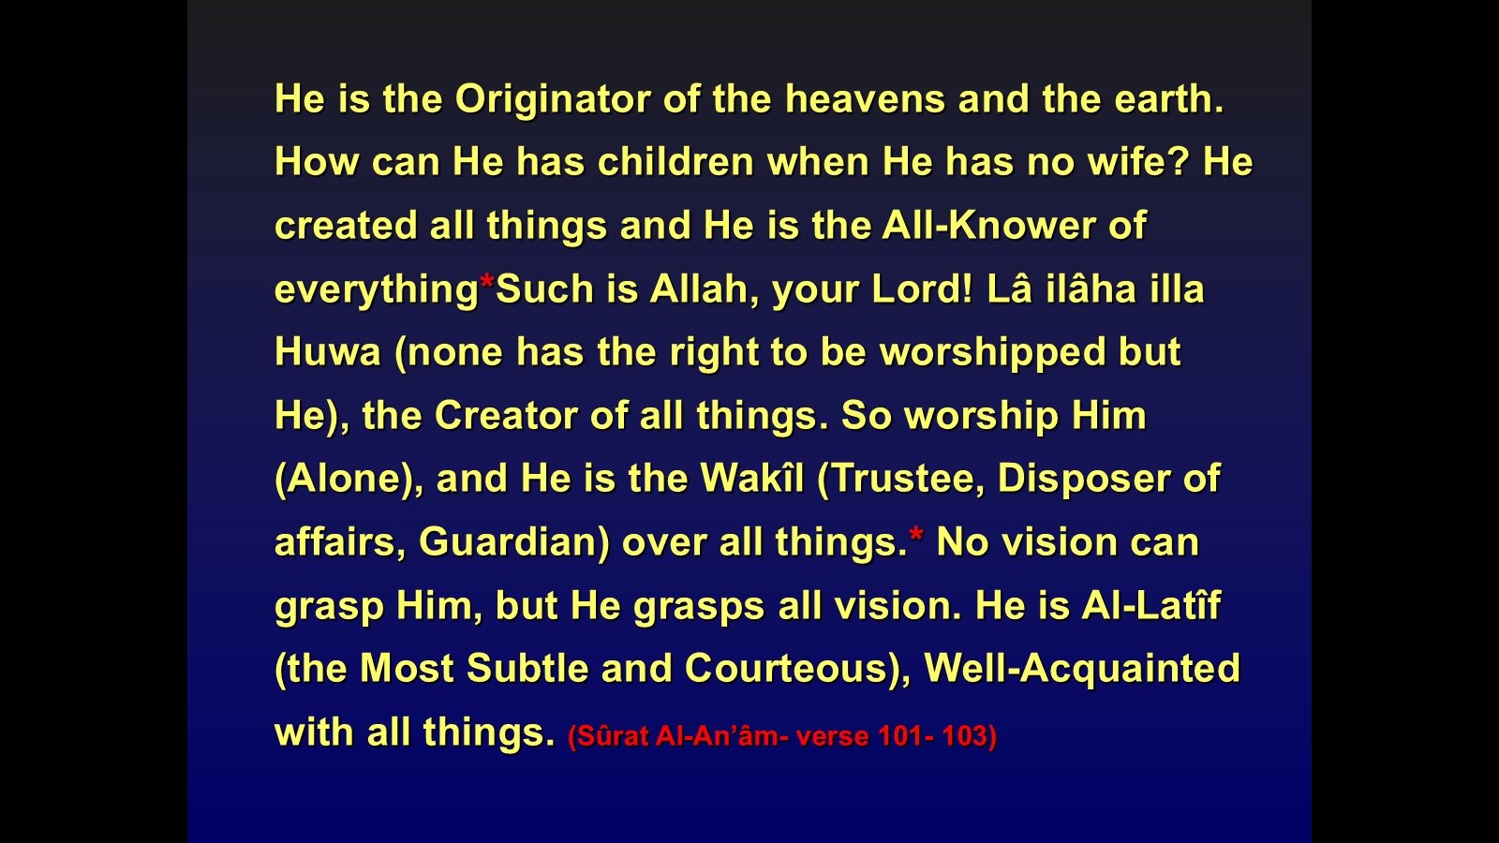
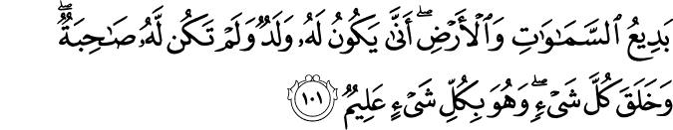
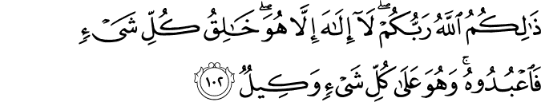
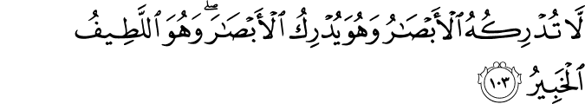

Slide 54
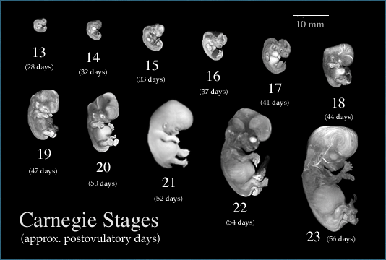
Order of Formation of the Human Body
Recent research proved “During the seventh
week
the skeleton begins to spread
the bones take their familiar shapes
At the end of the seventh week and during
the eighth week
the muscles take their positions around the bone forms.(Moore, Developing Human, 6. edition,1998.)
“We then formed the drop into a clot and formed the clot into a lump and formed the lump into bones and clothed the bones in flesh; and then brought him into being as another creature. Blessed be God, the Best of Creators!" (The Qur'an, 23:14)

Slide 55
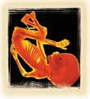
Human embryonic developments
In the Holy Quran, Allah speaks about the stages of man’s embryonic development:
23:12-14 ] "We created man from an extract of clay. Then We made him as a drop[ in a place of settlement, firmly fixed. Then We made the drop into an alaqah (leech, suspended thing, and blood clot), then We made the alaqah into a mudghah (chewed-like substance)...“
Literally, the Arabic word alaqah has three meanings: (1) leech, (2) suspended thing, and (3) blood clot.

Slide 56
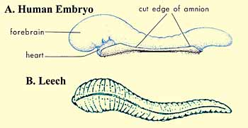
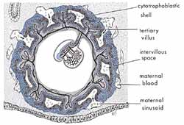
Similarities in appearance between a leech and a human embryo at the alaqah stage
The suspension of an embryo during the alaqah stage in the womb (uterus) of the mother

Slide 57
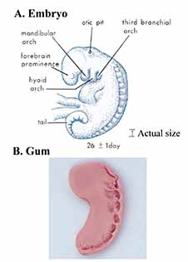
A) Drawing of an embryo at the mudghah stage. We can see here the somites at the back of the embryo that look like teeth marks. (The Developing Human, Moore and Persaud, 5th ed., p. 79.)
B) Photograph of a piece of gum that has been chewed
The Developing Human, Moore and Persaud, 5th ed., p. 79.)SS

Slide 58
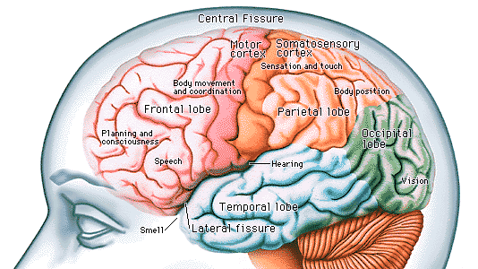
Cerebrum
Allah has said in the Quran about one of the evil unbelievers who forbade the Prophet Muhammad from praying at the Kaaba:
[96:15-16 ] "No! If he does not stop, We will take him by the naseyah (front of the head), a lying, sinful naseyah (front of the head)!"

Slide 59
What Others say about Quran Miracles ?
“This verse from the Koran states that God made you from a drop and then changed the drop into a leech-like structure which soon changed into a chewed like substance that then took the shape of bone and was clothed with flesh”. I was amazed at the scientific accuracy of these statements which was made in the 7th century A.D.”.
Dr. Moore was Professor of Anatomy and Chairman of the Department, Faculty of Medicine, at the University of Toronto
“The Quran describes not only the development of external form, but emphasizes also the internal stages, the stages inside the embryo, of its creation and development, emphasizing major events recognized by contemporary science”.
Dr. E. Marshall Johnson is Professor Emeruits of Anatomy and Developmental Biology at Thomas Jefferson University, Philadelphia, Pennsylvania, USA.
“In a relatively few Ayaha (Quranic verses) is contained a rather comprehensive description of human development from the time of commingling of the gametes through organogenesis. No such distinct and complete record of human development, such as classification, terminology, and description, existed previously. In most, if not all, instances, this description antedates by many centuries the recording of the various stages of human embryonic and fetal development recorded in the traditional scientific literature”.
Dr. Gerald C. Goeringer is Course Director and Associate Professor of Medical Embryology at the Department of Cell Biology, School of Medicine, Georgetown University, Washington, DC, USA.

Slide 60
Quran Miracles
Video (Part IV): Quran Miracles Challenge the Non-Beleivers -Universe

Slide 61
Quran Miracles Video (Part IV):
Quran Miracles Challenge the Non-Beleivers - Universe
https://www.youtube.com/watch?v=Pg21wmGYsJE

